Slide 1
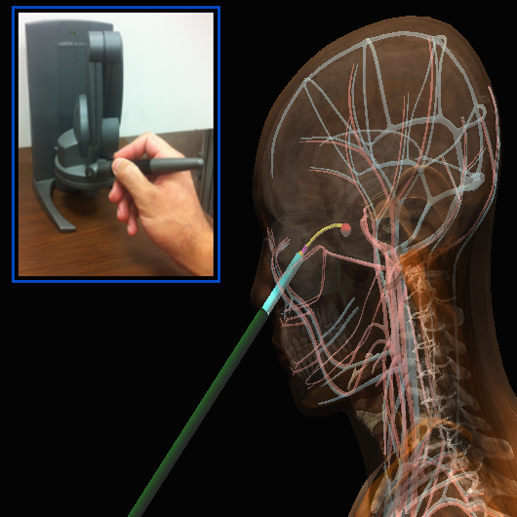
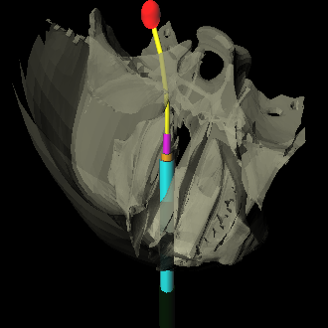
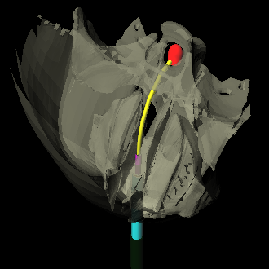
Motion Planning for Concentric Tube Robots
Ahmet Hatip, Chris Hemmer, Paul Song, Eric Xin
University of North Carolina at Chapel Hill
Notes:
use me

Slide 2
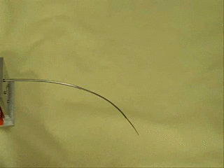
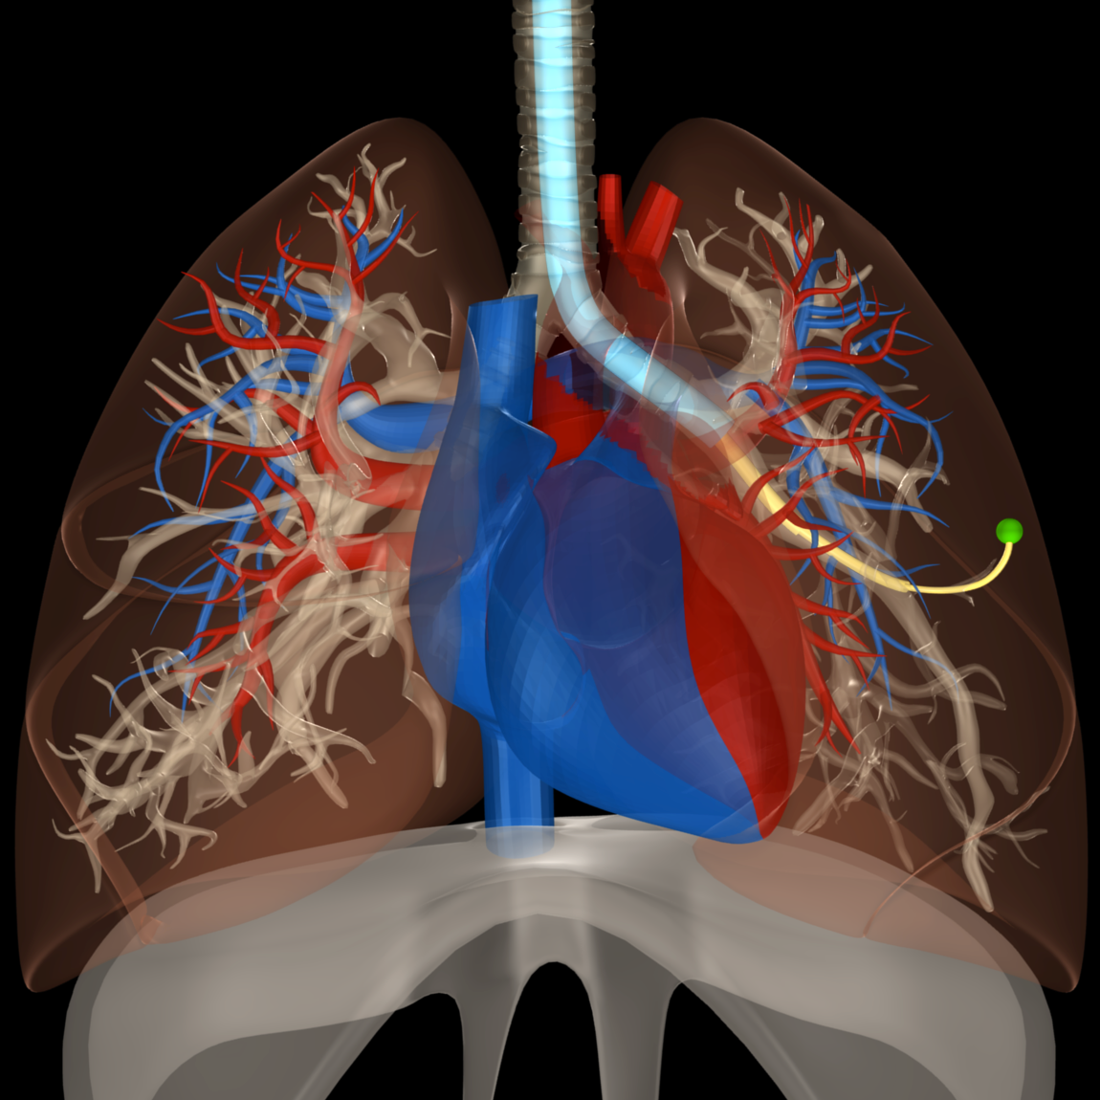
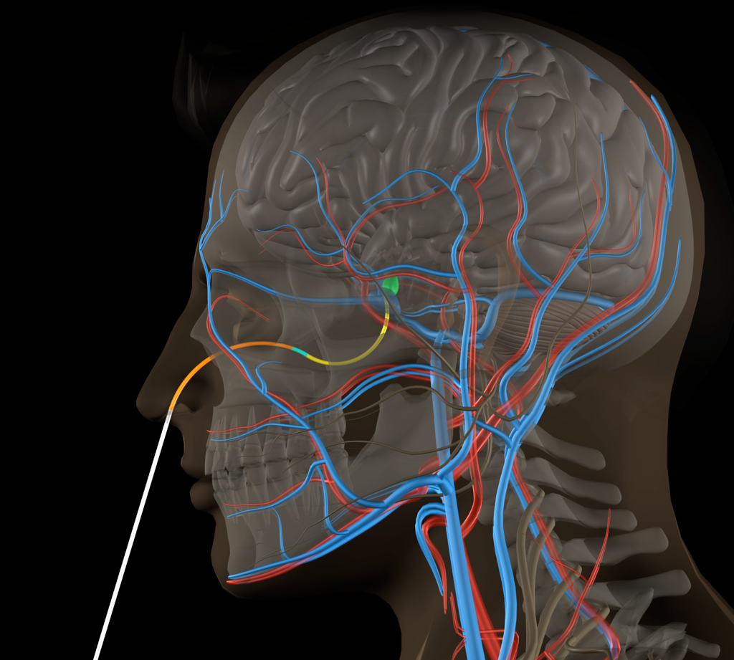
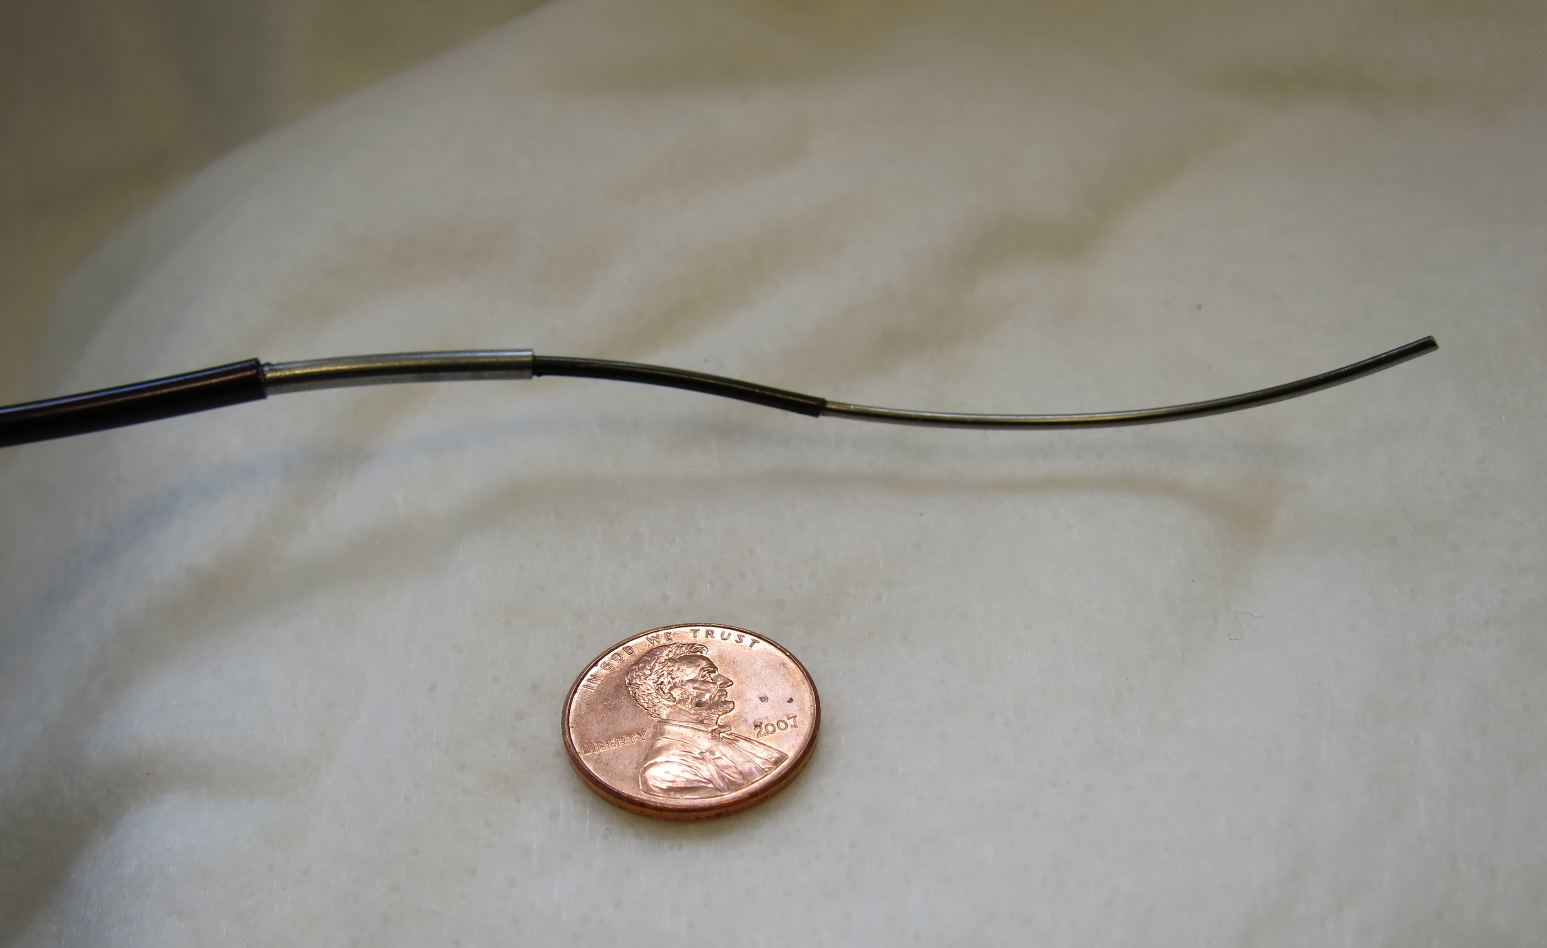
Concentric Tube Robots
Dr D. Caleb Rucker and Dr. Robert J. Webster III
Notes:
use me

Slide 3
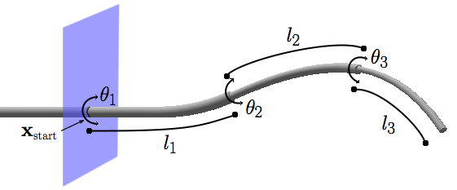
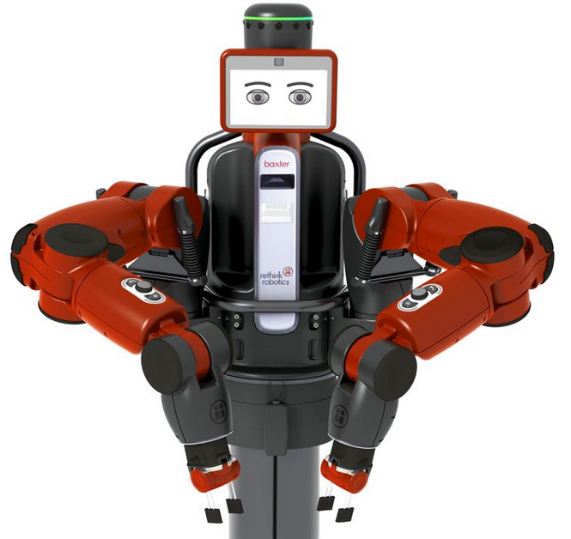
How do they work?
C-space: (n rotations x n translations)
Computation time:
Rethink Robotics
~0.001 seconds
~0.0000001 seconds
Notes:
use me

Slide 4



Acknowledgements
GRFP DGE-1144081
IIS-0905344
R01EB017467
MED Lab
IIS-1149965
R21EB017952
Luis G. Torres, Alan Kuntz, Hunter B. Gilbert, Philip J. Swaney, Richard J. Hendrick, Robert J. Webster III, and Ron Alterovitz, "A Motion Planning Approach to Automatic Obstacle Avoidance during Concentric Tube Robot Teleoperation," in Proc. IEEE International Conference on Robotics and Automation (ICRA), May 2015, pp. 2361-2367
Luis G. Torres, Cenk Baykal, and Ron Alterovitz, "Interactive-rate Motion Planning for Concentric Tube Robots," in Proc. IEEE International Conference on Robotics and Automation (ICRA), May 2014, pp. 1915-1921.

